Slide 1
BCS 370 Data Structures
Arthur Hoskey, Ph.D.
Farmingdale State College
Computer Systems Department

Slide 2
Today’s Lecture
Chapter 8 ADT Binary Search Trees (continued)
Created By Arthur Hoskey, PhD

Slide 3
Recursive Search
Now we will walk through searching for items in the tree…

Slide 4
Recursive Search
‘J’
‘E’
‘T’
‘A’
‘H’
‘M’
‘V’
‘D’
‘K’
‘P’
‘Z’
‘B’
‘L’
‘Q’
Are ‘D’, ‘Q’, and ‘N’ in the tree?
‘S’

Slide 5
Recursive Search
‘J’
‘E’
‘T’
‘A’
‘H’
‘M’
‘V’
‘D’
‘K’
‘P’
‘Z’
‘B’
‘L’
‘Q’
How does a search D proceed?
‘S’

Slide 6
Recursive Search
Is root = ‘D’?
‘J’
‘E’
‘T’
‘A’
‘H’
‘M’
‘V’
‘D’
‘K’
‘P’
‘Z’
‘B’
‘L’
‘Q’
Always check the root first
‘S’

Slide 7
Recursive Search
Is root = ‘D’?
NO. Where do we go now?
‘J’
‘E’
‘T’
‘A’
‘H’
‘M’
‘V’
‘D’
‘K’
‘P’
‘Z’
‘B’
‘L’
‘Q’
Always check the root first
‘S’

Slide 8
Recursive Search
If ‘D’ is < root then go left otherwise go right
‘J’
‘E’
‘T’
‘A’
‘H’
‘M’
‘V’
‘D’
‘K’
‘P’
‘Z’
‘B’
‘L’
‘Q’
Always check the root first
‘S’

Slide 9
Recursive Search
‘D’ is < root so follow the left child
‘J’
‘E’
‘T’
‘A’
‘H’
‘M’
‘V’
‘D’
‘K’
‘P’
‘Z’
‘B’
‘L’
‘Q’
Always check the root first
‘S’

Slide 10
Recursive Search
‘E’ is the “root” of a subtree
‘J’
Does ‘D’ = ‘E’ ?
‘E’
‘T’
‘A’
‘H’
‘M’
‘V’
‘D’
‘K’
‘P’
‘Z’
‘B’
‘L’
‘Q’
Always check the root first
‘S’

Slide 11
Recursive Search
‘E’ is the “root” of a subtree
Does ‘D’ = ‘E’ ?
NO. Now where do we go
‘J’
‘E’
‘T’
‘A’
‘H’
‘M’
‘V’
‘D’
‘K’
‘P’
‘Z’
‘B’
‘L’
‘Q’
Always check the root first
‘S’

Slide 12
Recursive Search
‘A’ is the “root” of a subtree
‘D’ < ‘E’ so go left
‘J’
‘E’
‘T’
‘A’
‘H’
‘M’
‘V’
‘D’
‘K’
‘P’
‘Z’
‘B’
‘L’
‘Q’
Always check the root first
‘S’

Slide 13
Recursive Search
‘A’ is the “root” of a subtree
Does ‘D’ = ‘A?
‘J’
‘E’
‘T’
‘A’
‘H’
‘M’
‘V’
‘D’
‘K’
‘P’
‘Z’
‘B’
‘L’
‘Q’
Always check the root first
‘S’

Slide 14
Recursive Search
‘A’ is the “root” of a subtree
Does ‘D’ = ‘A?
NO. So now where do we go?
‘J’
‘E’
‘T’
‘A’
‘H’
‘M’
‘V’
‘D’
‘K’
‘P’
‘Z’
‘B’
‘L’
‘Q’
Always check the root first
‘S’

Slide 15
Recursive Search
‘D’ is the “root” of a subtree
‘J’
‘E’
‘T’
‘A’
‘H’
‘M’
‘V’
‘D’
‘K’
‘P’
‘Z’
Go to the right child of ‘A’
‘B’
‘L’
‘Q’
Always check the root first
‘S’

Slide 16
Recursive Search
‘D’ is the “root” of a subtree
‘J’
‘E’
‘T’
‘A’
‘H’
‘M’
‘V’
‘D’
‘K’
‘P’
‘Z’
Does ‘D’ = ‘D’ . Yes, so we are done
‘B’
‘L’
‘Q’
Always check the root first
‘S’

Slide 17
Binary Search Tree (linked)
void TreeType::RetrieveItem(TreeNode* tree, int& item, bool& found)
{
if (tree == NULL)
found = false;
else if (item < tree->info)
Retrieve(tree->left, item, found);
else if (item > tree->info)
Retrieve(tree->right, item, found);
else
{
item = tree->info;
found = true;
}
}
At bottom of tree so item not there
Check the left subtree
Check the right subtree
FOUND IT!!!

Slide 18
Binary Search Tree (linked)
IsFull
Similar to IsFull for the linked implementations of the other data structures we have covered.
IsEmpty
Similar to IsEmpty for the linked implementations of the other data structures we have covered.

Slide 19
Binary Search Tree (linked)
Insert
Now we will insert items into a binary search tree…

Slide 20
Shape of BST
Shape depends on the order of item insertion
Insert the elements ‘J’ ‘E’ ‘F’ ‘T’ ‘A’ in that order
The first value inserted is always put in the root
‘J’

Slide 21
Shape of BST
Thereafter, each value to be inserted
compares itself to the value in the root node
moves left it is less or
moves right if it is greater
When does the process stop?
‘J’
‘E’

Slide 22
Shape of BST
Trace path to insert ‘F’
‘J’
‘E’
‘F’

Slide 23
Shape of BST
Trace path to insert ‘T’
‘J’
‘E’
‘T’
‘F’

Slide 24
Shape of BST
Trace path to insert ‘A’
‘J’
‘E’
‘T’
‘A’
‘F’

Slide 25
Shape of BST
Now build tree by inserting ‘A’ ‘E’ ‘F’ ‘J’ ‘T’ in that order
And the moral is?

Slide 26
Shape of BST
Now build tree by inserting ‘A’ ‘E’ ‘F’ ‘J’ ‘T’ in that order
‘A’

Slide 27
Shape of BST
Now build tree by inserting ‘A’ ‘E’ ‘F’ ‘J’ ‘T’ in that order
‘A’
‘E’

Slide 28
Shape of BST
Now build tree by inserting ‘A’ ‘E’ ‘F’ ‘J’ ‘T’ in that order
‘A’
‘E’
‘F’

Slide 29
Shape of BST
Now build tree by inserting ‘A’ ‘E’ ‘F’ ‘J’ ‘T’ in that order
‘A’
‘E’
‘F’
‘J’

Slide 30
Shape of BST
Now build tree by inserting ‘A’ ‘E’ ‘F’ ‘J’ ‘T’ in that order
‘A’
‘E’
What is the problem with this shape???
‘F’
‘J’
‘T’

Slide 31
Shape of BST
Now build tree by inserting ‘A’ ‘E’ ‘F’ ‘J’ ‘T’ in that order
‘A’
‘E’
Degenerated into a list because of insertion order!
‘F’
‘J’
‘T’

Slide 32
Recursive Insertion
Insert an item into a tree
Where does each new node get inserted?
Insert(tree, item)
if (tree is NULL)
Get a new node
Set right and left to NULL
Set info to item

Slide 33
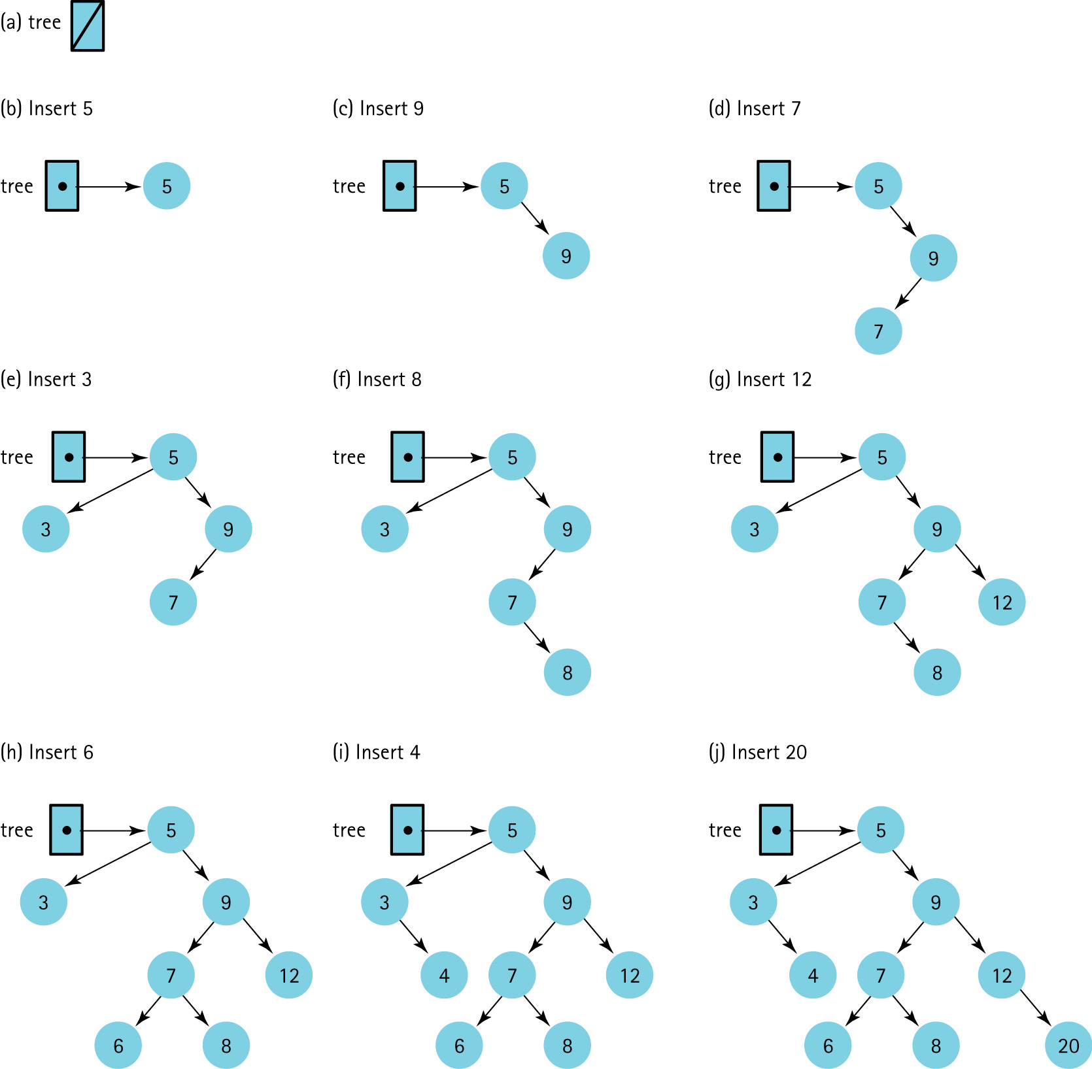
Recursive Insertion

Slide 34
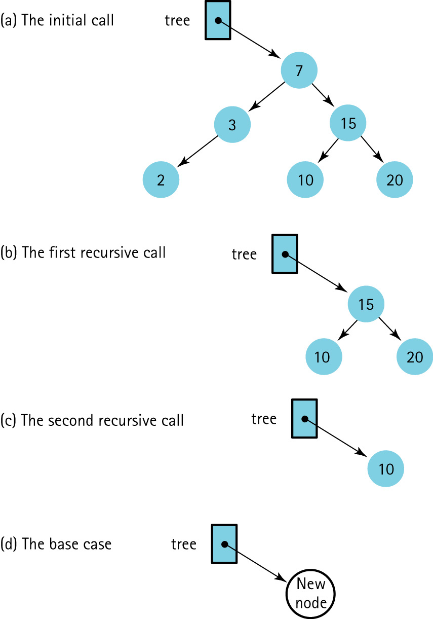
Recursive Insertion

Slide 35
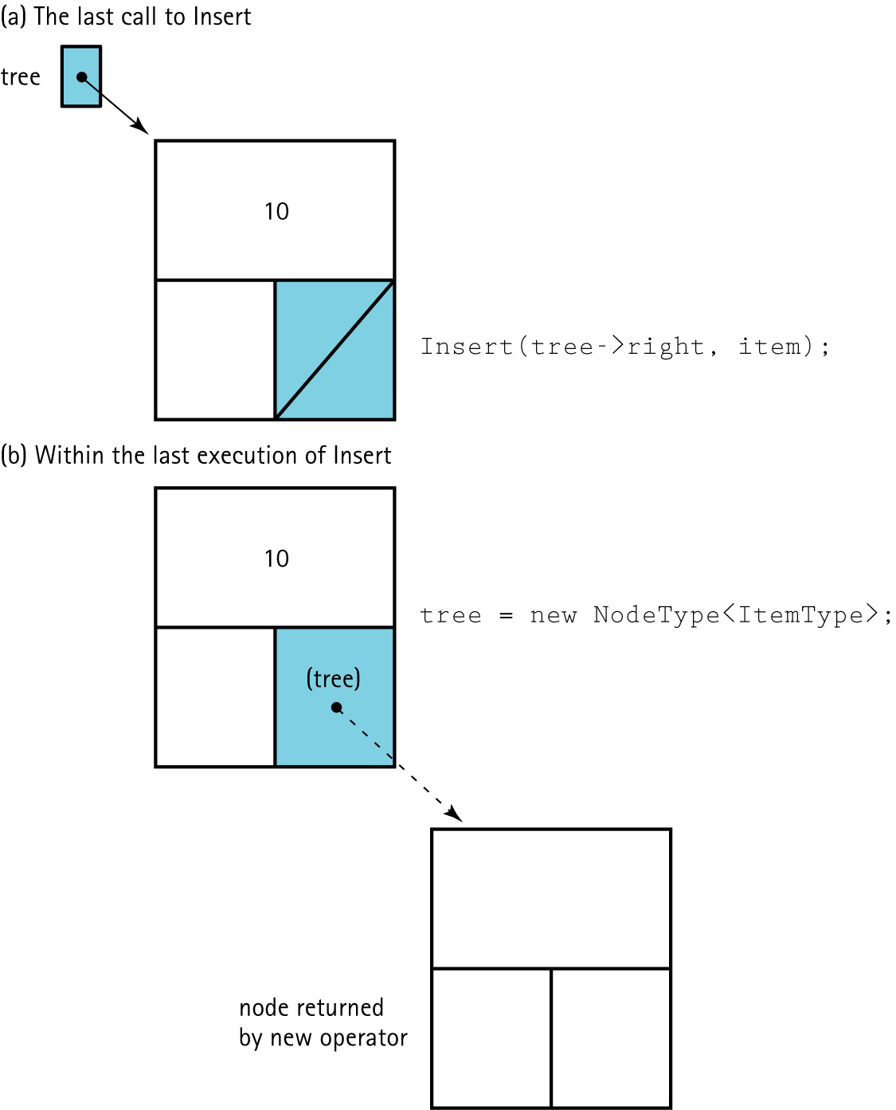
Recursive Insertion
How must
the tree
be
passed?

Slide 36
Recursive Insertion
void TreeType::Insert(TreeNode*& tree, int item)
{
if (tree == NULL)
{// Insertion place found.
tree = new TreeNode;
tree->right = NULL;
tree->left = NULL;
tree->info = item;
}
else if (item < tree->info)
Insert(tree->left, item);
else
Insert(tree->right, item);
}
Pass the pointer by reference so the change is “seen” by the calling method.

Slide 37
Binary Search Tree (linked)
Delete
Now we will delete items from a binary search tree…

Slide 38
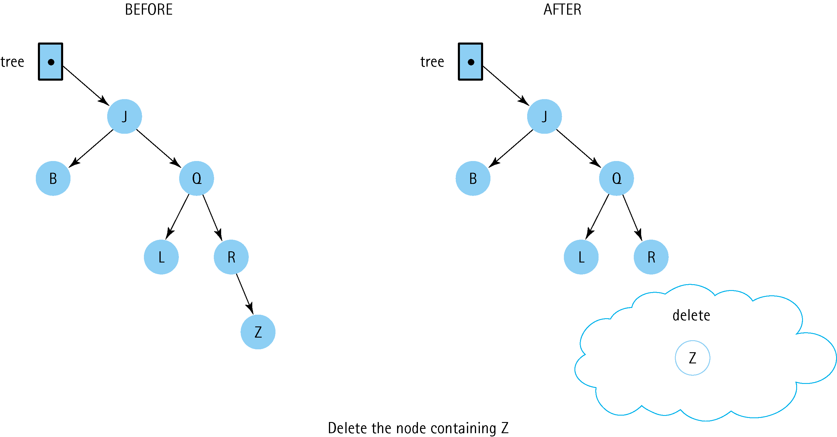
Recursive Deletion
Delete ‘Z’

Slide 39
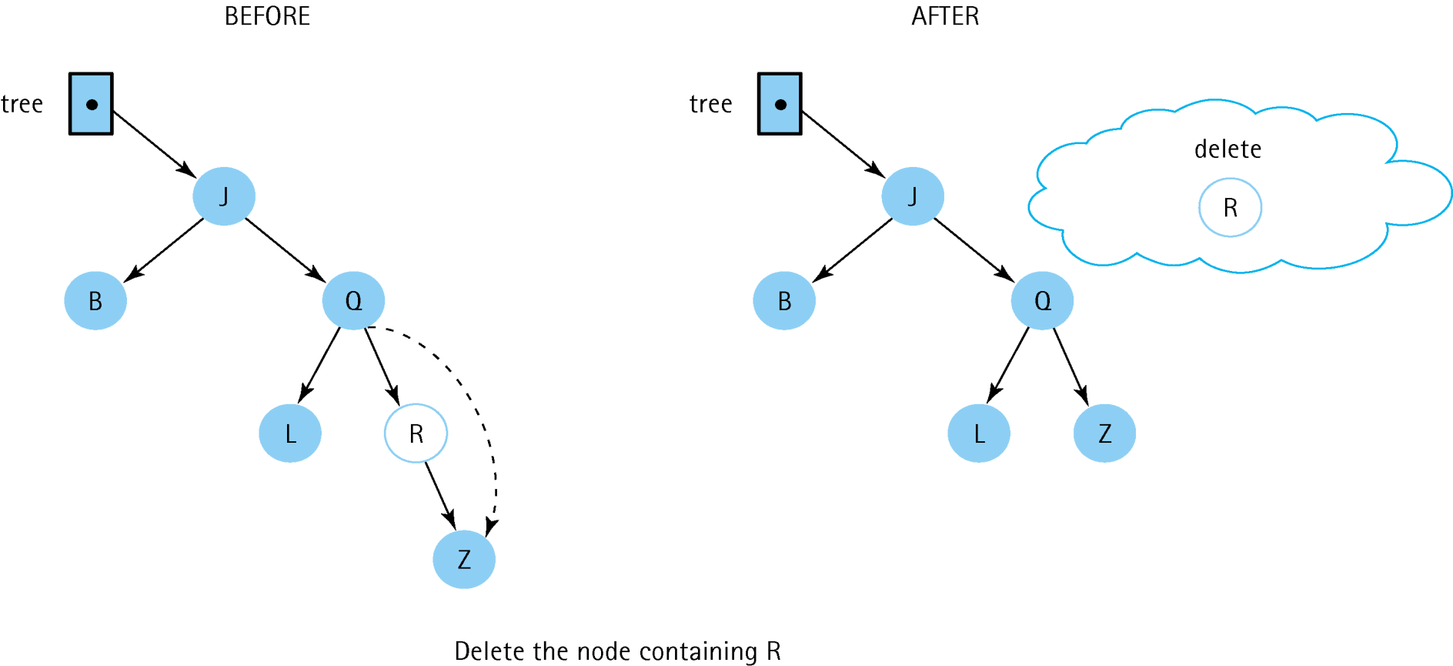
Recursive Deletion
Delete ‘R’

Slide 40
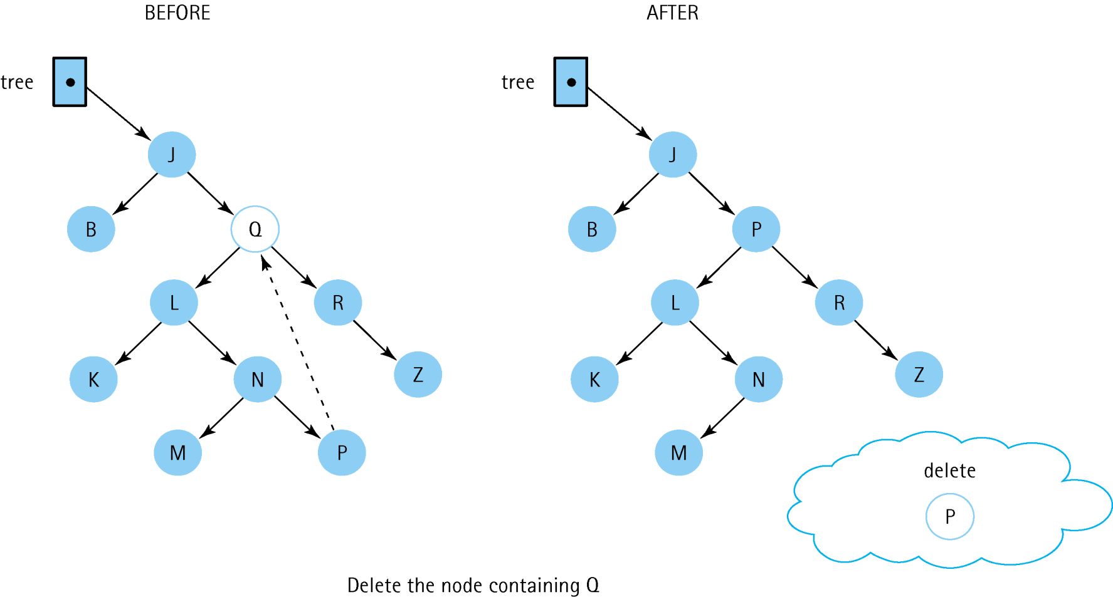
Recursive Deletion
Delete ‘Q’
What is going on here???
Will explain soon.

Slide 41
Recursive Deletion
Can you summarize the three deletion cases?
Created By Arthur Hoskey, PhD

Slide 42
Recursive Deletion
Three Deletion Cases
Leaf – Delete node is a leaf. Delete the node and set the child pointer of parent to null.
One child – Delete node has one child. Delete the node and fix the child pointer of the parent to point to the appropriate child of the node to be deleted.
Two children – Delete node has two children. Copy the data from the predecessor into the node to be deleted. The predecessor is the largest value in the left subtree of the node to be deleted. Finally, delete the predessor node.
Created By Arthur Hoskey, PhD

Slide 43
Recursive Deletion
Delete ‘Q’
P is the pred of Q.
Search property is preserved

Slide 44
Recursive Deletion
DeleteItem(tree, item)
if (Left(tree) is NULL) AND (Right(tree) is NULL)
Set tree to NULL
else if Left(tree) is NULL
Set tree to Right(tree)
else if Right(tree) is NULL
Set tree to Left(tree)
else
Find predecessor
Set Info(tree) to Info(predecessor)
Delete predecessor

Slide 45
Recursive Deletion
void Delete(TreeNode*& tree, ItemType item)
{
if (item < tree->info)
delete(tree->left, item);
else if (item > tree->info)
delete(tree->right, item);
else
DeleteNode(tree); // Node found
}
item < subtree root
item > subtree root
Found the node so delete it!!!
Pass the pointer by reference so the change is “seen” by the calling method.

Slide 46
Recursive Deletion
void DeleteNode(TreeNode*& tree)
{
int data;
Node* tempPtr;
tempPtr = tree;
if (tree->left == NULL) {
tree = tree->right;
delete tempPtr; }
else if (tree->right == NULL) {
tree = tree->left;
delete tempPtr;}
else {
GetPredecessor(tree->left, data);
tree->info = data;
Delete(tree->left, data);
}
}
If there is only one child then just rearrange pointers
Find pred and move that data in
Find original pred node and delete it

Slide 47
Recursive Deletion
void GetPredecessor(TreeNode* tree, int& data)
{
while (tree->right != NULL)
tree = tree->right;
data = tree->info;
}
Why is the code not recursive?

Slide 48
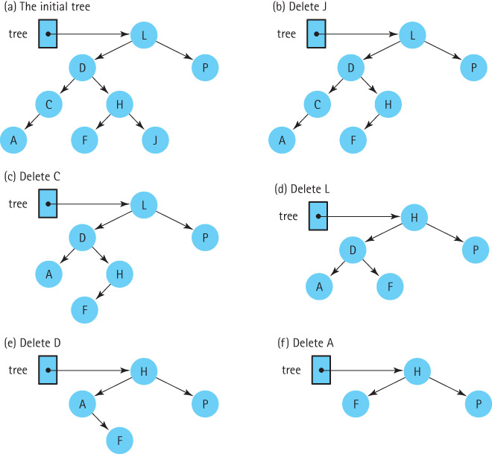
Recursive Deletion

Slide 49
Attendance
Take attendance now!!!
Created By Arthur Hoskey, PhD

Slide 50
End of Slides
End of Slides
Created By Arthur Hoskey, PhD

